Slide 1
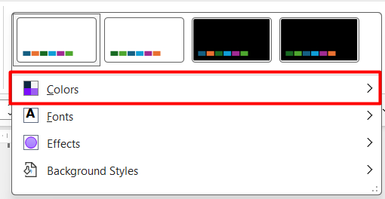
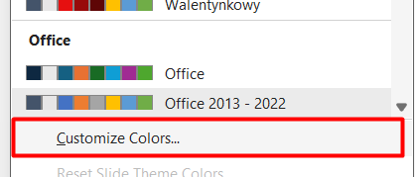

Did you already apply colors in the previous lecture? Great, you are done with the assignment!
If not, please test it out here :)
1. Click on Design
2. Open Variants - > select Colors
3. Select „Customize Colors”
#7C0DFF
#9C5EF2
#C4A2F2
#5005F2
#6CF1D6
#15D9AF
#F2F2F2

Slide 2


Brand book

